Slide 1
Lecture 10 CUDA Instructions
Kyu Ho Park
May 2, 2017
Ref:[PCCP]Professional CUDA C Programming

Slide 2
Issues
Applications:
I/O-bound applications
Compute-bound applications
Low-level instruction tuning
double value= a*b + c;//MAD(multiply-add)
This pattern is so common, modern architectures support a MAD instruction that fuses a multiply and an add operation.

Slide 3
MAD instruction
The number of cycles to execute the MAD operation is halved.
The results of a single MAD instruction are often less numerically accurate that with separate multiply and add instructions.

Slide 4
CUDA Instructions
Three topics that significantly affect the instructions generated for a CUDA kernel:
floating point operation
: Affect both accuracy and performance of CUDA programs
intrinsic and standard functions,
: they implement overlapping sets of mathematical operations but offer different accuracy and performance.
atomic instructions
:they guarantee correctness of concurrent operations on
a variable from multiple threads.

Slide 5
Floating-Point Instructions Issues
Accuracy of floating-point arithmetic
Precision of floating-point number representation
Consideration in parallel computation

Slide 6
Floating-Point Format
IEEE floating-point standard:
A numerical value is represented in three groups of bits,
S(sign),E(Exponent) and M(Mantissa).
value=(-1)^{S} x 1.M x {2^{E-bias}}
,where S=0 means a positive number and
S=1 a negative number.
sign | exponent | fraction

Slide 7
32-bit and 64-bit format
float
1 | 8 | 23
double
1 | 11 | 52

Slide 8
Representation of M
value=(-1)^{S} x 1.M x {2^{E-bias}}
Example: a decimal number 0.5, represented by 0.5_{D.}
0.5_{D}=1.0_{B} x 2⁻¹ , therefore M=0.
The numbers that satisfy this restriction is referred to as
normalized numbers. The mantissa of 0.5_{D} in a 2-bit mantissa representation is 00. by omitting 1. from 1.00.

Slide 9
Floating-Point Intructions
float a=3.1415927;
float b=3.1415928;
if(a==b) {
printf(“a is equal to b\n”);
} else {
printf(“a is not equal to b\n”);
}

Slide 10
On architecture compatible with the IEEE754, the output is
“ a is equal to b”.
Floating point values are rounded to representable value.

Slide 11
double a=3.1415927;
double b=3.1415928;
if(a==b) {
printf(“a is equal to b\n”);
} else {
printf(“a is not equal to b\n”);
}

Slide 12
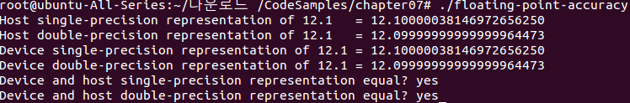
Single and Double Precision

Slide 13
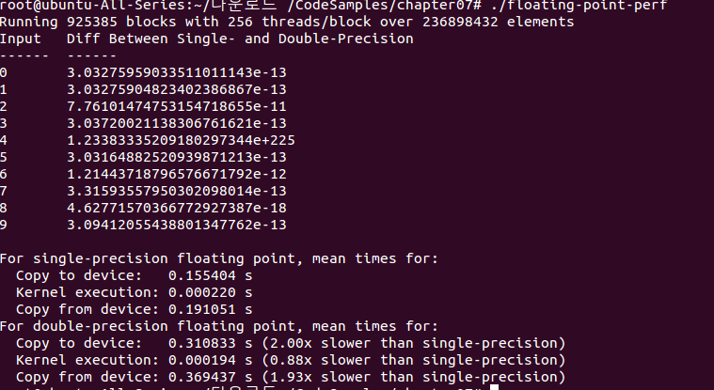
Single and Double Precision

Slide 14
Algorithmic Considerations
Consider 1 bit S, 2 bits M, 2 bits E.
1.00_{B} x2⁰ +1.00_{B} x2⁰ +1.00_{B} x2⁻² +1.00_{B} x2⁻² =?
(((1.00_{B} x2⁰ +1.00_{B} x2⁰ ) +1.00_{B} x2⁻² )
+1.00_{B} x2⁻² )= (1.00_{B} x2¹+ 1.00_{B} x2⁻² )
+1.00_{B} x2⁻² = 1.00_{B} x2¹ + 1.00_{B} x2⁻²
= 1.00_{B} x2¹

Slide 15
Algorithmic Considerations
1.00_{B} x2⁰ +1.00_{B} x2⁰ +1.00_{B} x2⁻² +1.00_{B} x2⁻² =(1.00_{B} x2⁰ +1.00_{B} x2⁰ )+(1.00_{B} x2⁻² +1.00_{B} x2⁻² )
=1.00_{B} x2¹ + 1.00_{B} x2⁻¹ = 1.01_{B} x 2¹

Slide 16
Algorithmic Considerations
A technique to maximize floating point arithmetic accuracy is to sort data before a reduction computation.
Divide the numbers into groups in a parallel algorithm. And use each thread to sequentially reduce values within each group,
Having the numbers sorted in ascending order allows a sequential addition to get higher accuracy.
[Kahan, Further remarks on reducing truncation errors,Communications of ACM,8(1)40.]

Slide 17
Intrinsic and Standard Functions
CUDA arithmetic functions:
Intrinsic functions:
They can be accessed only from device code.
Many trigonometric functions which are directly implemented in hardware on GPUs.
Standard functions:
It includes C standard math library, single- instruction operations like multiplication and addition.
Standard and intrinsic functions differ in both numerical accuracy and performance. Standard functions provide full support for a wide range of arithmetic operations. However, many have equivalent intrinsic functions that implement the same functionality but with fewer instructions, improved performance and lower numerical accuracy

Slide 18
Atomic Instructions
An atomic instructions performs a mathematical operation in a single uninterruptable operation with no interference from other threads.
CUDA provides atomic functions that perform read-modify-write atomic operations on 32-bits or 64-bits of global memory and shared memory.

Slide 19
Atomic Instructions
Each atomic function implements a basic mathematical operation such as addition, multiplication, or subtraction.
Atomic instructions have a defined behavior when operating on a memory location shared by two competing threads.

Slide 20
Atomic Instructions
A kernel:
__global__ void incr(int *ptr){
int temp=*ptr;
temp=temp+1;
*ptr=temp;
}
If a single block of 32 threads were launched running this kernel, what output will it be?

Slide 21
Atomic Instruction
int atomicAdd( int *M, int V);
//the atomic function is executed on V and the value already stored at location, *M and the result is saved to the same memory location.
__global__ void incr(__global__ int *ptr){
int temp=atomicAdd(ptr,1);
}

Slide 22
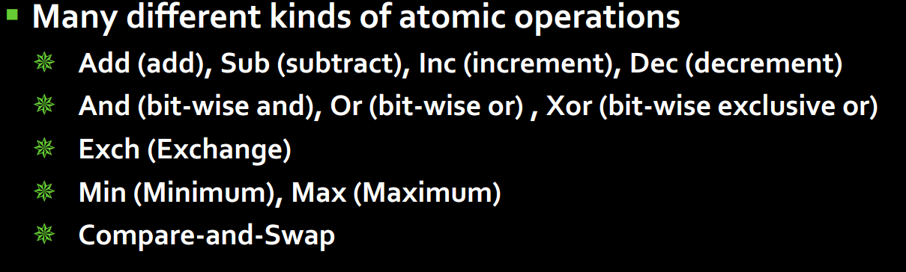
Atomic Operations

